Slide 1
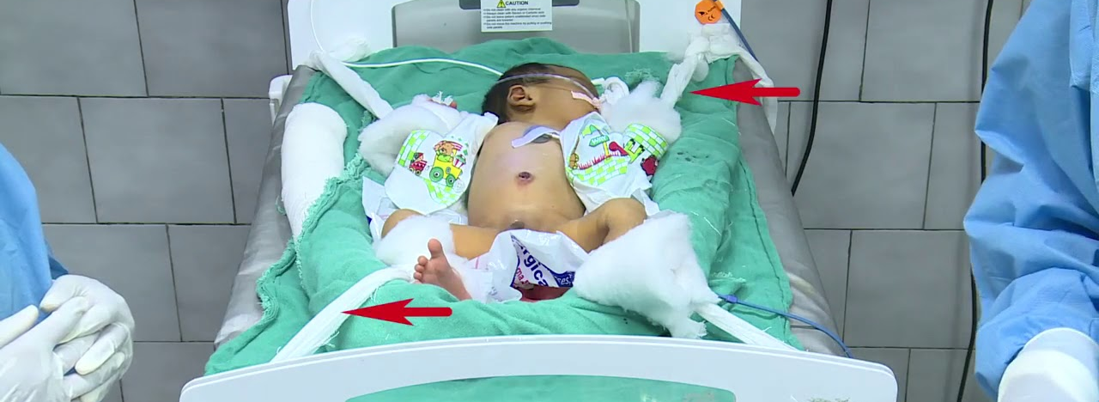
AUTOMATED NEONATAL EXCHANGE TRANSFUSION
ANET 4.0

Slide 2



GROUP MEMBERS
Bandoma Gideon
8273719
Ameyaw Arthur Samuel
8272619
Cann Josephine
8274419

Slide 3
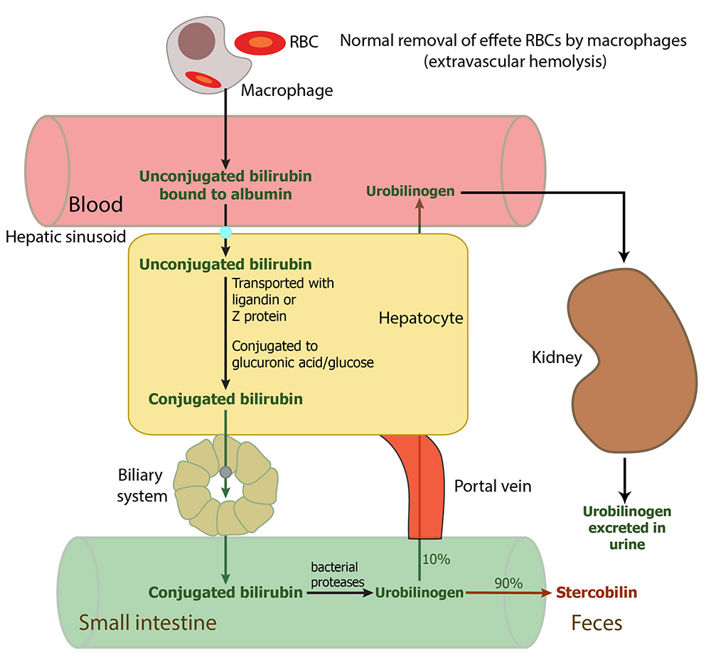
Background
Blood-related issues such as jaundice, hyperbilirubinemia, and hemolytic disease are present in newborns.
In Ghana these blood diseases are predominant.

Slide 4


Statistics of Hyperbilirubinemia occurrence
over 60%
of term infants
80%
of preterm infants

Slide 5
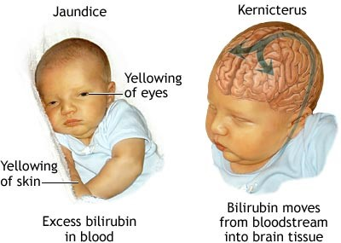
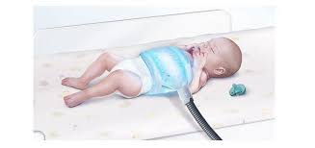
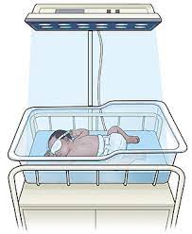
Background
lack the devices for early detection like bilirubin meters used in other countries.
Severe cases lead to brain damage or neurodevelopmental issues
Other Interventions
The aim of this project would be to reduce human interaction when exchange transfusion takes place.

Slide 6
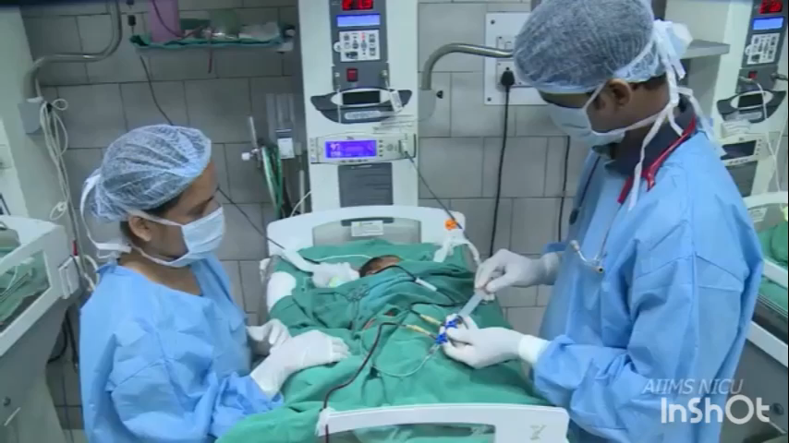
Exchange Transfusion
Slow withdrawal of blood usually through catheters inserted into a blood vessel
replacing it with fresh blood from a donor
Two techniques for the blood exchange transfusion
Single catheter
double catheter

Slide 7
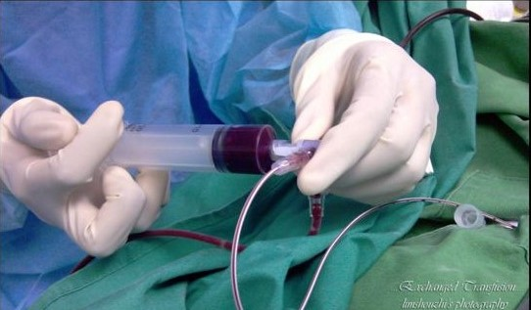
Problem Statement
ET is a very tedious and time-consuming process.
This makes the procedure although a life-saving one seem unappealing

Slide 8


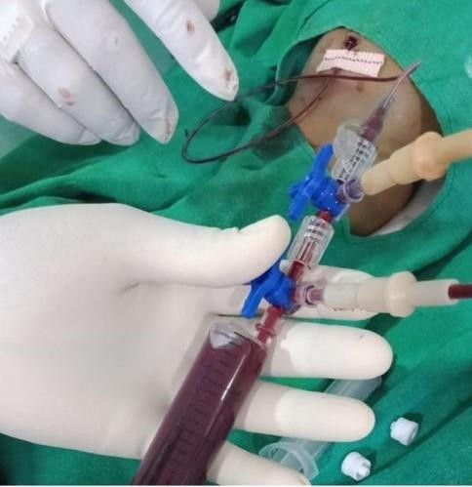
Scope of the Project
▫ Solve ANET 3.0 challenges
▫ Animal testing
▫ Further improvement
8

Slide 9
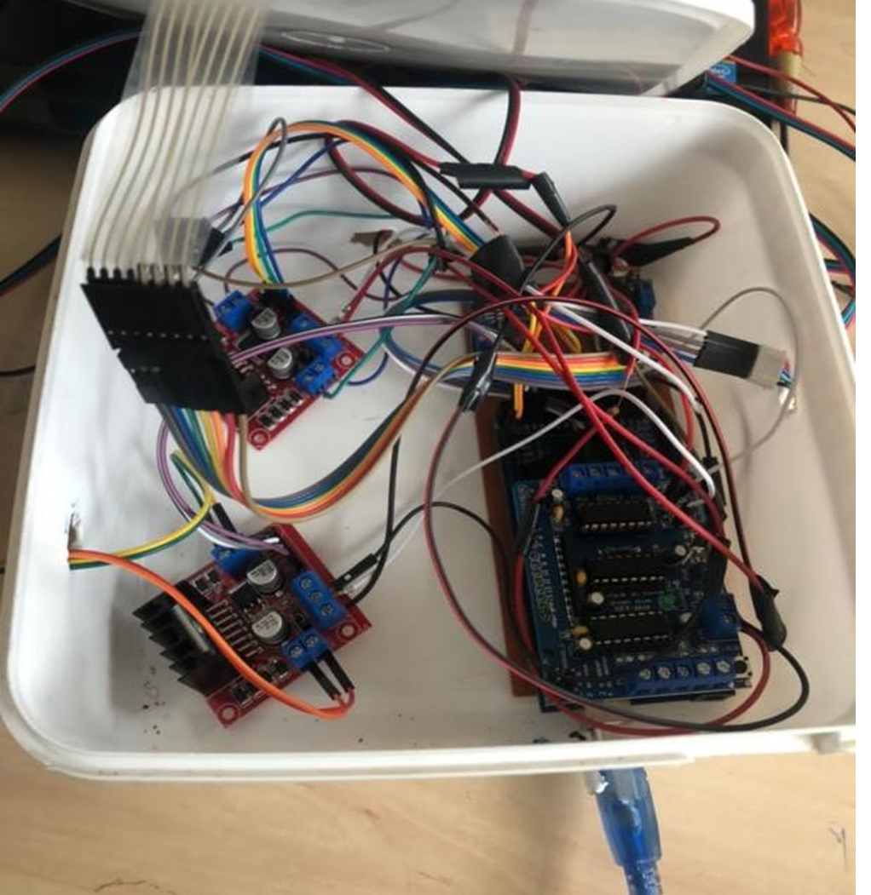
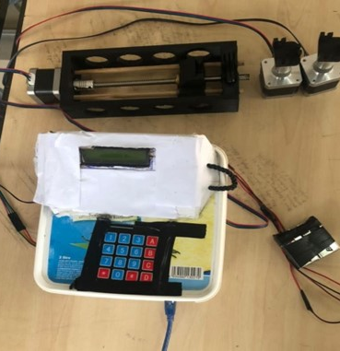
ANET 3.0
High friction threaded rods, wobbling effects
Overheating
Plunging effect
Valve switching system
Power supply

Slide 10
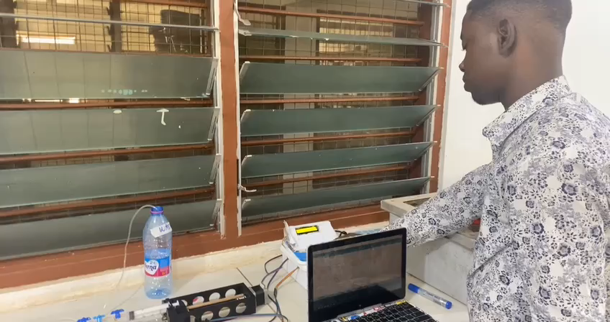
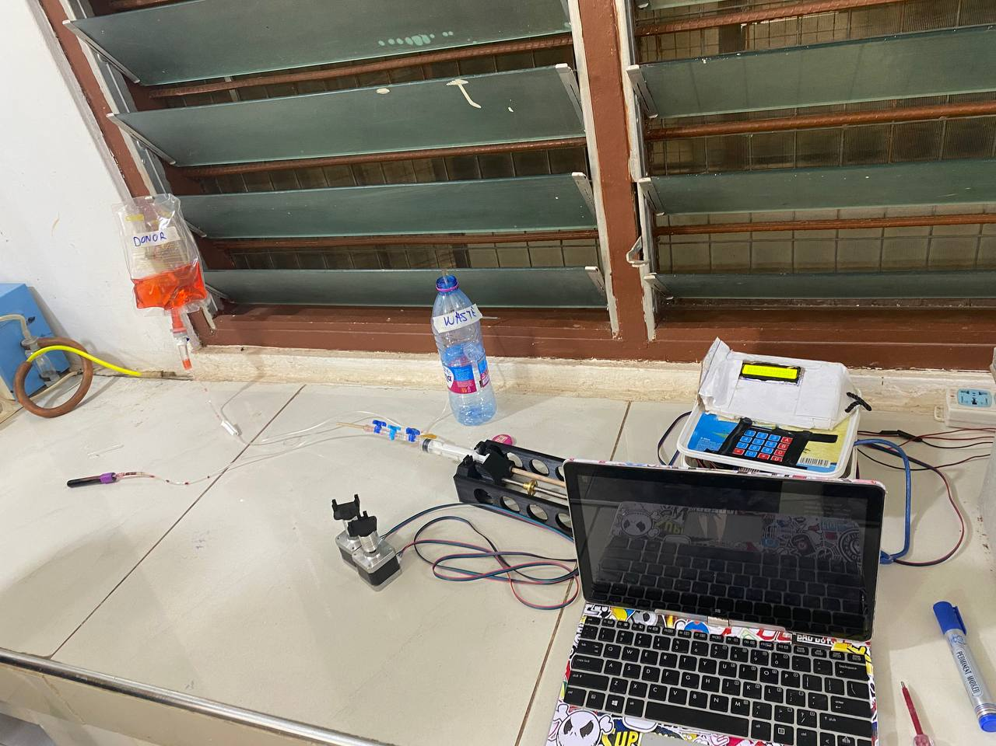
Animal Testing
Evaluate the efficacy of the device or demonstrate proof of principle
Provide evidence of safety, including performance and handling
Compare with existing automation attempts and procedure
Risk assessment for risk management
10

Slide 11

ANET 4.0 OBJECTIVES
S
SPECIFIC
Implement a system that is automated, using classical electronics to improve plunging at a low cost. And adding an alarm system.
M
MEASURABLE
Quantify coupler torque
Quantify the pressure required
A
Highly attainable
ATTAINABLE
R
RELEVANT
A major resort in our part of the world for solving Hyperbilirubinemia
T
Project expected to be completed within 7 months with prototype testing .
TIMELY
11

Slide 12
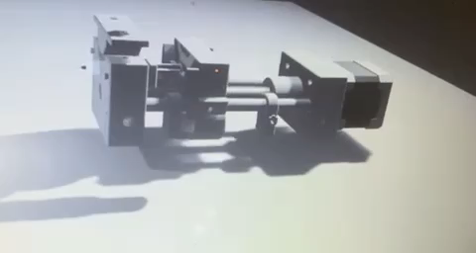
ANET 4.0
1. Mechanics – Syringe pump
12

Slide 13
ANET 4.0
2. Electronics – block diagram
13

Slide 14




Thank You

